Slide 1
ECE 532
CHAPTER 5: SEARCH AND SORTING (PART 3: LINEARITHMIC SORTING - MERGE AND QUICK SORTS)
Lecturer: Dr. Roslina Mohamad
Room: Tower 2, Level 13, No:14C

Slide 2
Learning Outcomes
In this chapter, you will:
Learn the linearithmic sorting algorithms
Implement quick and merge sorting algorithms
Compare sorting algorithm performance

Slide 3
Quicksort
A more efficient exchange sorting scheme than bubble sort
  A typical exchange involves elements that are far apart
  Fewer interchanges are required to correctly position an element.
Quicksort uses a divide-and-conquer strategy
  A recursive approach
  The original problem partitioned into simpler sub-problems,
  Each sub problem considered independently.
Subdivision continues until sub problems obtained are simple enough to be solved directly

Slide 4
Quicksort
Choose some element called a pivot
Perform a sequence of exchanges so that
  All elements that are less than this pivot are to its left and
  All elements that are greater than the pivot are to its right.
Divides the (sub)list into two smaller sub lists,
Each of which may then be sorted independently in the same way.

Slide 5
Quick Sort: Array-Based Lists
Quick sort: uses the divide-and-conquer technique
  The list is partitioned into two sublists
  Each sublist is then sorted
  Sorted sublists are combined into one list in such a way that the combined list is sorted
  All of the sorting work occurs during the partitioning of the list

Slide 6
Quick Sort: Array-Based Lists
pivot element is chosen to divide the list into: lowerSublist and upperSublist
  The elements in lowerSublist are < pivot
  The elements in upperSublist are ≥ pivot
Pivot can be chosen in several ways
  Ideally, the pivot divides the list into two sublists of
  nearly- equal size

Slide 7
Functions of Quicksort
A recursive function, called quicksort
A nonrecursive function, usually called partition
quicksort calls partition

Slide 8
Refer to Chapter Recursion (Example 2.8)
void quickSort(int set[], int start, int end)
{ int pivotPoint;
if (start < end)
{
// Get the pivot point.
pivotPoint = partition(set, start, end);
cout<<"Pivot point= "<<pivotPoint<<endl;
// Sort the first sub list.
quickSort(set, start, pivotPoint - 1);
// Sort the second sub list.
quickSort(set, pivotPoint + 1, end);
}
}

Slide 9
Quick Sort: Array-Based Lists
Partition algorithm (assumes that pivot is chosen as the middle element of the list):
  Determine pivot; swap it with the first element of the list
  For the remaining elements in the list:
    If the current element is less than pivot, (1) increment smallIndex, and (2) swap current element with element pointed by smallIndex
  Swap the first element (pivot), with the array element pointed to by smallIndex

Slide 10
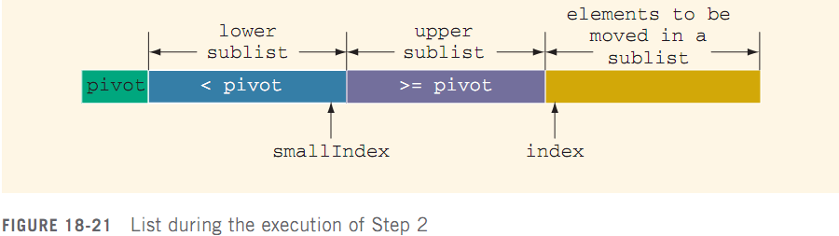
Quick Sort: Array-Based Lists
Step 1 determines the pivot and moves pivot to the first array position
During Step 2, list elements are arranged

Slide 11
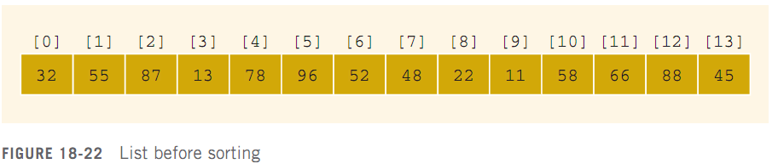
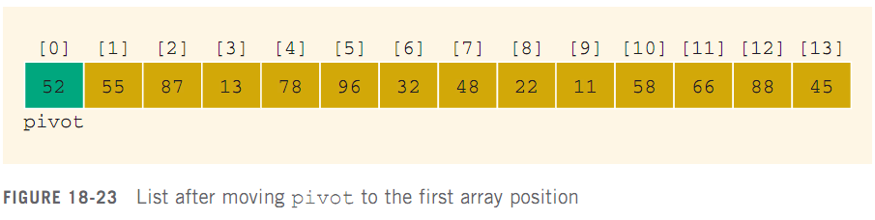
Quick Sort: Array-Based Lists

Slide 12
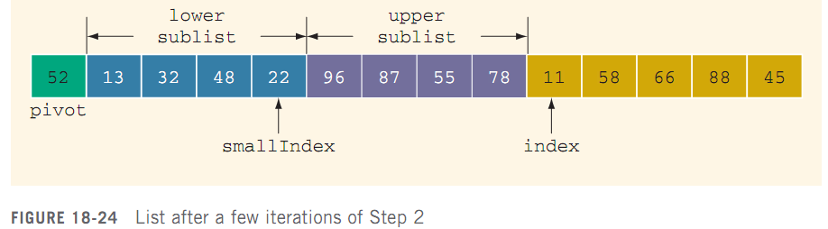
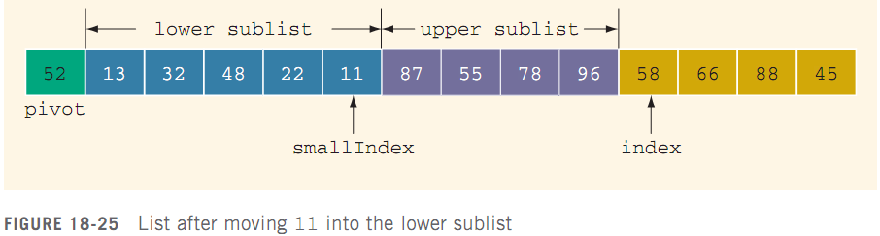
Quick Sort: Array-Based Lists

Slide 13
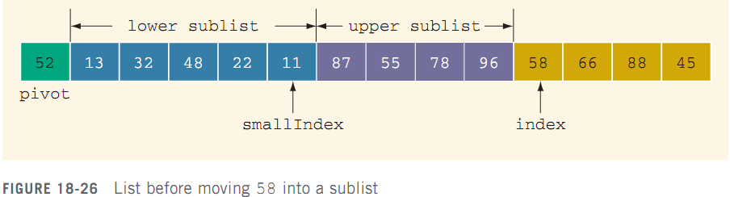
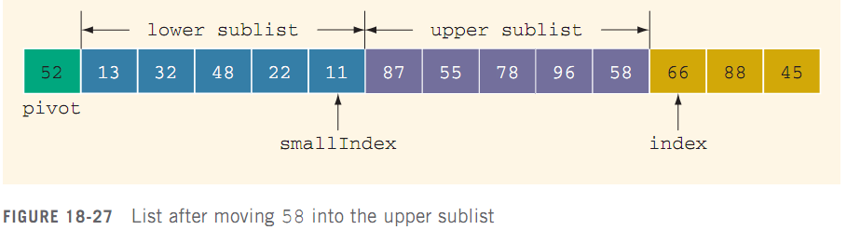
Quick Sort: Array-Based Lists

Slide 14
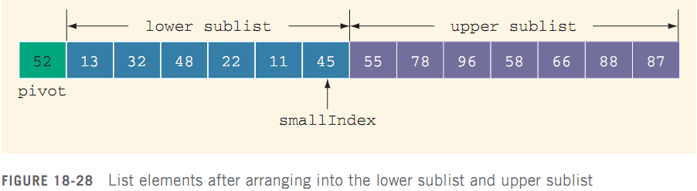
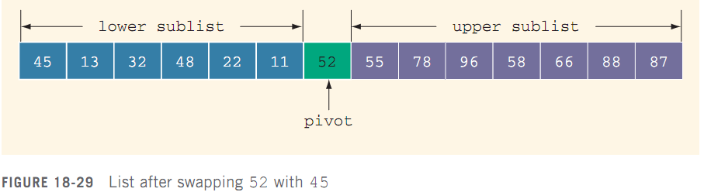
Quick Sort: Array-Based Lists (cont’d.)

Slide 15
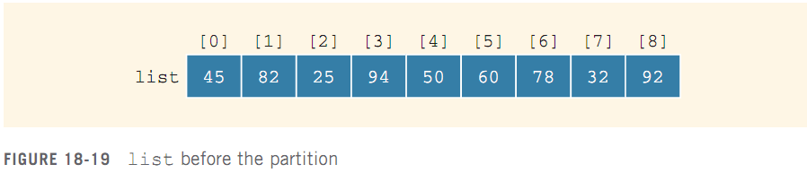
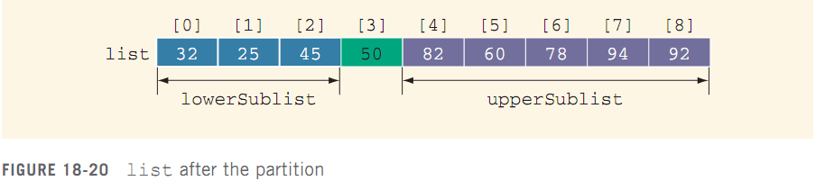
Quick Sort: Array-Based Lists (cont’d.)

Slide 16
Partition
pivot
0 1 2 3 4 5 6 7 8 9 10 11
14
28
10
35
46
47
6
3
38
11
4
28
In the partition function, the last element is chosen as a pivot – a special element used for comparison purposes

Slide 17
Partition (cont.)
pivot
0 1 2 3 4 5 6 7 8 9 10 11
14
28
10
35
46
47
6
3
38
11
4
28
Each element is compared to the pivot. When partition is done, it produces the result shown next…

Slide 18
Partition (cont.)
pivot
0 1 2 3 4 5 6 7 8 9 10 11
14
28
10
35
46
47
6
3
38
11
4
28
0 1 2 3 4 5 6 7 8 9 10 11
14
28
10
6
3
11
4
28
38
47
35
46
All elements less than or equal to the pivot are on its left

Slide 19
Partition (cont.)
pivot
0 1 2 3 4 5 6 7 8 9 10 11
14
28
10
35
46
47
6
3
38
11
4
28
0 1 2 3 4 5 6 7 8 9 10 11
14
28
10
6
3
11
4
28
38
47
35
46
All elements greater than the pivot are on its right side

Slide 20
Partition (cont.)
pivot
0 1 2 3 4 5 6 7 8 9 10 11
14
28
10
35
46
47
6
3
38
11
4
28
0 1 2 3 4 5 6 7 8 9 10 11
14
28
10
6
3
11
4
28
38
47
35
46
The pivot is where it will be in the final sorted array

Slide 21
Partition (cont.)
0 1 2 3 4 5 6 7 8 9 10 11
14
28
10
6
3
11
4
28
38
47
35
46
Partition is called from quicksort more than once, but when called again, it will work with a smaller section of the array.

Slide 22
Partition (cont.)
pivot
0 1 2 3 4 5 6 7 8 9 10 11
14
2
10
35
46
47
6
3
38
11
4
28
Partition has a loop which iterates through each element, comparing it to the pivot

Slide 23
Partition (cont.)
pivot
0 1 2 3 4 5 6 7 8 9 10 11
14
28
10
35
46
47
6
3
38
11
4
28
partitioned section
unpartitioned section
When partition is in progress, there is a partitioned section on the left, and an unpartitioned section on the right

Slide 24
Partition (cont.)
pivot
0 1 2 3 4 5 6 7 8 9 10 11
14
28
10
35
46
47
6
3
38
11
4
28
partitioned section
unpartitioned section
The dividing line in the partitioned section means that all elements to the left are less than or equal to the pivot; all elements to the right are greater than the pivot

Slide 25
Partition (cont.)
pivot
0 1 2 3 4 5 6 7 8 9 10 11
14
28
10
35
46
47
6
3
38
11
4
28
partitioned section
unpartitioned section
On each iteration, the partitioned section grows by one and the unpartitioned section shrinks by one, until the array is fully partitioned

Slide 26
Partition (cont.)
pivot
0 1 2 3 4 5 6 7 8 9 10 11
14
28
10
35
46
47
6
3
38
11
4
28
partitioned section
unpartitioned section
i is an index used to mark the last value in the small side of the partition, while j is used to mark the first value in the unpartitioned section.

Slide 27
Partition (cont.)
pivot
i
j
0 1 2 3 4 5 6 7 8 9 10 11
14
28
10
35
46
47
6
3
38
11
4
28
partitioned section
unpartitioned section
i is an index used to mark the last value in the small side of the partition, while j is used to mark the first value in the unpartitioned section.

Slide 28
Partition (cont.)
pivot
i
j
0 1 2 3 4 5 6 7 8 9 10 11
14
28
10
35
46
47
6
3
38
11
4
28
partitioned section
unpartitioned section
On each iteration of partition, the value at j is compared to the pivot.

Slide 29
Partition (cont.)
pivot
i
j
0 1 2 3 4 5 6 7 8 9 10 11
14
28
10
35
46
47
6
3
38
11
4
28
partitioned section
unpartitioned section
On each iteration of partition, the value at j is compared to the pivot.

Slide 30
Partition (cont.)
pivot
i
j
0 1 2 3 4 5 6 7 8 9 10 11
14
28
10
35
46
47
6
3
38
11
4
28
partitioned section
unpartitioned section
If the value at j is greater, j is just incremented (the partitioned section grows by one)

Slide 31
Partition (cont.)
pivot
i
j
0 1 2 3 4 5 6 7 8 9 10 11
14
28
10
35
46
47
6
3
38
11
4
28
partitioned section
unpartitioned section
If the value at j is greater, j is just incremented (the partitioned section grows by one)

Slide 32
Partition (cont.)
pivot
i
j
0 1 2 3 4 5 6 7 8 9 10 11
14
28
10
35
46
47
6
3
38
11
4
28
partitioned section
unpartitioned section
If, on an iteration, the value at j is less than the pivot…

Slide 33
Partition (cont.)
pivot
i
j
0 1 2 3 4 5 6 7 8 9 10 11
14
28
10
35
46
47
6
3
38
11
4
28
partitioned section
unpartitioned section
then i is incremented…

Slide 34
Partition (cont.)
pivot
i
j
0 1 2 3 4 5 6 7 8 9 10 11
14
28
10
35
46
47
6
3
38
11
4
28
partitioned section
unpartitioned section
then i is incremented…

Slide 35
Partition (cont.)
pivot
i
j
0 1 2 3 4 5 6 7 8 9 10 11
14
28
10
35
46
47
6
3
38
11
4
28
partitioned section
unpartitioned section
and the value at i is swapped with the value at j…

Slide 36
Partition (cont.)
pivot
i
j
6
0 1 2 3 4 5 6 7 8 9 10 11
35
14
28
10
46
47
3
38
11
4
28
partitioned section
unpartitioned section
and the value at i is swapped with the value at j…

Slide 37
Partition (cont.)
pivot
i
j
6
0 1 2 3 4 5 6 7 8 9 10 11
35
14
28
10
46
47
3
38
11
4
28
partitioned section
unpartitioned section
and the value at i is swapped with the value at j…

Slide 38
Partition (cont.)
pivot
i
j
6
0 1 2 3 4 5 6 7 8 9 10 11
35
14
28
10
46
47
3
38
11
4
28
partitioned section
unpartitioned section
and the value at i is swapped with the value at j…

Slide 39
Partition (cont.)
pivot
i
j
0 1 2 3 4 5 6 7 8 9 10 11
6
35
14
28
10
46
47
3
38
11
4
28
partitioned section
unpartitioned section
and the value at i is swapped with the value at j…

Slide 40
Partition (cont.)
pivot
i
j
0 1 2 3 4 5 6 7 8 9 10 11
14
28
10
6
46
47
35
3
38
11
4
28
partitioned section
unpartitioned section
and the value at i is swapped with the value at j…

Slide 41
Partition (cont.)
pivot
i
j
0 1 2 3 4 5 6 7 8 9 10 11
14
28
10
6
46
47
35
3
38
11
4
28
partitioned section
unpartitioned section
then j is incremented

Slide 42
Partition (cont.)
pivot
i
j
0 1 2 3 4 5 6 7 8 9 10 11
14
28
10
6
46
47
35
3
38
11
4
28
partitioned section
unpartitioned section
then j is incremented

Slide 43
Partition (cont.)
p
i
j
r
0 1 2 3 4 5 6 7 8 9 10 11
14
28
10
6
46
47
35
3
38
11
4
28
1 partition( arr, p, r )
2 i = p – 1
3 for all j from p to r – 1
4 if arr[ j ] <= arr[ r ]
5 i++
6 swap( arr[ i ], arr[ j ] )
7 swap ( arr[ i + 1 ] and arr[ r ] )
8 return i + 1
j is currently 7, with partition having already iterated through elements 0 through 6

Slide 44
Partition (cont.)
p
i
j
r
0 1 2 3 4 5 6 7 8 9 10 11
14
28
10
6
46
47
35
3
38
11
4
28
1 partition( arr, p, r )
2 i = p – 1
3 for all j from p to r – 1
4 if arr[ j ] <= arr[ r ]
5 i++
6 swap( arr[ i ], arr[ j ] )
7 swap ( arr[ i + 1 ] and arr[ r ] )
8 return i + 1

Slide 45
Partition (cont.)
p
i
j
r
0 1 2 3 4 5 6 7 8 9 10 11
14
28
10
6
46
47
35
3
38
11
4
28
1 partition( arr, p, r )
2 i = p – 1
3 for all j from p to r – 1
4 if arr[ j ] <= arr[ r ]
5 i++
6 swap( arr[ i ], arr[ j ] )
7 swap ( arr[ i + 1 ] and arr[ r ] )
8 return i + 1

Slide 46
Partition (cont.)
p
i
j
r
0 1 2 3 4 5 6 7 8 9 10 11
14
28
10
6
46
47
35
3
38
11
4
28
1 partition( arr, p, r )
2 i = p – 1
3 for all j from p to r – 1
4 if arr[ j ] <= arr[ r ]
5 i++
6 swap( arr[ i ], arr[ j ] )
7 swap ( arr[ i + 1 ] and arr[ r ] )
8 return i + 1

Slide 47
Partition (cont.)
p
i
j
r
0 1 2 3 4 5 6 7 8 9 10 11
14
28
10
6
46
47
35
3
38
11
4
28
1 partition( arr, p, r )
2 i = p – 1
3 for all j from p to r – 1
4 if arr[ j ] <= arr[ r ]
5 i++
6 swap( arr[ i ], arr[ j ] )
7 swap ( arr[ i + 1 ] and arr[ r ] )
8 return i + 1

Slide 48
Partition (cont.)
p
i
j
r
0 1 2 3 4 5 6 7 8 9 10 11
46
3
14
28
10
6
47
35
38
11
4
28
1 partition( arr, p, r )
2 i = p – 1
3 for all j from p to r – 1
4 if arr[ j ] <= arr[ r ]
5 i++
6 swap( arr[ i ], arr[ j ] )
7 swap ( arr[ i + 1 ] and arr[ r ] )
8 return i + 1

Slide 49
Partition (cont.)
p
i
j
r
3
0 1 2 3 4 5 6 7 8 9 10 11
46
14
28
10
6
47
35
38
11
4
28
1 partition( arr, p, r )
2 i = p – 1
3 for all j from p to r – 1
4 if arr[ j ] <= arr[ r ]
5 i++
6 swap( arr[ i ], arr[ j ] )
7 swap ( arr[ i + 1 ] and arr[ r ] )
8 return i + 1

Slide 50
Partition (cont.)
p
i
j
r
3
0 1 2 3 4 5 6 7 8 9 10 11
46
14
28
10
6
47
35
38
11
4
28
1 partition( arr, p, r )
2 i = p – 1
3 for all j from p to r – 1
4 if arr[ j ] <= arr[ r ]
5 i++
6 swap( arr[ i ], arr[ j ] )
7 swap ( arr[ i + 1 ] and arr[ r ] )
8 return i + 1

Slide 51
Partition (cont.)
p
i
j
r
0 1 2 3 4 5 6 7 8 9 10 11
3
46
14
28
10
6
47
35
38
11
4
28
1 partition( arr, p, r )
2 i = p – 1
3 for all j from p to r – 1
4 if arr[ j ] <= arr[ r ]
5 i++
6 swap( arr[ i ], arr[ j ] )
7 swap ( arr[ i + 1 ] and arr[ r ] )
8 return i + 1

Slide 52
Partition (cont.)
p
i
j
r
0 1 2 3 4 5 6 7 8 9 10 11
14
28
10
6
3
47
35
46
38
11
4
28
1 partition( arr, p, r )
2 i = p – 1
3 for all j from p to r – 1
4 if arr[ j ] <= arr[ r ]
5 i++
6 swap( arr[ i ], arr[ j ] )
7 swap ( arr[ i + 1 ] and arr[ r ] )
8 return i + 1

Slide 53
Partition (cont.)
p
i
j
r
0 1 2 3 4 5 6 7 8 9 10 11
14
28
10
6
3
47
35
46
38
11
4
28
1 partition( arr, p, r )
2 i = p – 1
3 for all j from p to r – 1
4 if arr[ j ] <= arr[ r ]
5 i++
6 swap( arr[ i ], arr[ j ] )
7 swap ( arr[ i + 1 ] and arr[ r ] )
8 return i + 1

Slide 54
Partition (cont.)
p
i
j
r
0 1 2 3 4 5 6 7 8 9 10 11
14
28
10
6
3
47
35
46
38
11
4
28
1 partition( arr, p, r )
2 i = p – 1
3 for all j from p to r – 1
4 if arr[ j ] <= arr[ r ]
5 i++
6 swap( arr[ i ], arr[ j ] )
7 swap ( arr[ i + 1 ] and arr[ r ] )
8 return i + 1

Slide 55
Partition (cont.)
p
i
j
r
0 1 2 3 4 5 6 7 8 9 10 11
14
28
10
6
3
47
35
46
38
11
4
28
1 partition( arr, p, r )
2 i = p – 1
3 for all j from p to r – 1
4 if arr[ j ] <= arr[ r ]
5 i++
6 swap( arr[ i ], arr[ j ] )
7 swap ( arr[ i + 1 ] and arr[ r ] )
8 return i + 1

Slide 56
Partition (cont.)
p
i
j
r
0 1 2 3 4 5 6 7 8 9 10 11
14
28
10
6
3
47
35
46
38
11
4
28
1 partition( arr, p, r )
2 i = p – 1
3 for all j from p to r – 1
4 if arr[ j ] <= arr[ r ]
5 i++
6 swap( arr[ i ], arr[ j ] )
7 swap ( arr[ i + 1 ] and arr[ r ] )
8 return i + 1

Slide 57
Partition (cont.)
p
i
j
r
0 1 2 3 4 5 6 7 8 9 10 11
14
28
10
6
3
47
35
46
38
11
4
28
1 partition( arr, p, r )
2 i = p – 1
3 for all j from p to r – 1
4 if arr[ j ] <= arr[ r ]
5 i++
6 swap( arr[ i ], arr[ j ] )
7 swap ( arr[ i + 1 ] and arr[ r ] )
8 return i + 1

Slide 58
Partition (cont.)
p
i
j
r
0 1 2 3 4 5 6 7 8 9 10 11
14
28
10
6
3
47
35
46
38
11
4
28
1 partition( arr, p, r )
2 i = p – 1
3 for all j from p to r – 1
4 if arr[ j ] <= arr[ r ]
5 i++
6 swap( arr[ i ], arr[ j ] )
7 swap ( arr[ i + 1 ] and arr[ r ] )
8 return i + 1

Slide 59
Partition (cont.)
p
i
j
r
0 1 2 3 4 5 6 7 8 9 10 11
14
28
10
6
3
47
35
46
38
11
4
28
1 partition( arr, p, r )
2 i = p – 1
3 for all j from p to r – 1
4 if arr[ j ] <= arr[ r ]
5 i++
6 swap( arr[ i ], arr[ j ] )
7 swap ( arr[ i + 1 ] and arr[ r ] )
8 return i + 1

Slide 60
Partition (cont.)
p
i
j
r
0 1 2 3 4 5 6 7 8 9 10 11
14
28
10
6
3
47
35
46
38
11
4
28
1 partition( arr, p, r )
2 i = p – 1
3 for all j from p to r – 1
4 if arr[ j ] <= arr[ r ]
5 i++
6 swap( arr[ i ], arr[ j ] )
7 swap ( arr[ i + 1 ] and arr[ r ] )
8 return i + 1

Slide 61
Partition (cont.)
p
i
j
r
0 1 2 3 4 5 6 7 8 9 10 11
14
28
10
6
3
47
35
46
38
11
4
28
1 partition( arr, p, r )
2 i = p – 1
3 for all j from p to r – 1
4 if arr[ j ] <= arr[ r ]
5 i++
6 swap( arr[ i ], arr[ j ] )
7 swap ( arr[ i + 1 ] and arr[ r ] )
8 return i + 1

Slide 62
Partition (cont.)
p
i
j
r
0 1 2 3 4 5 6 7 8 9 10 11
14
28
10
6
3
47
35
46
38
11
4
28
1 partition( arr, p, r )
2 i = p – 1
3 for all j from p to r – 1
4 if arr[ j ] <= arr[ r ]
5 i++
6 swap( arr[ i ], arr[ j ] )
7 swap ( arr[ i + 1 ] and arr[ r ] )
8 return i + 1

Slide 63
Partition (cont.)
p
i
j
r
0 1 2 3 4 5 6 7 8 9 10 11
11
47
14
28
10
6
3
35
46
38
4
28
1 partition( arr, p, r )
2 i = p – 1
3 for all j from p to r – 1
4 if arr[ j ] <= arr[ r ]
5 i++
6 swap( arr[ i ], arr[ j ] )
7 swap ( arr[ i + 1 ] and arr[ r ] )
8 return i + 1

Slide 64
Partition (cont.)
p
i
j
r
11
0 1 2 3 4 5 6 7 8 9 10 11
47
14
28
10
6
3
35
46
38
4
28
1 partition( arr, p, r )
2 i = p – 1
3 for all j from p to r – 1
4 if arr[ j ] <= arr[ r ]
5 i++
6 swap( arr[ i ], arr[ j ] )
7 swap ( arr[ i + 1 ] and arr[ r ] )
8 return i + 1

Slide 65
Partition (cont.)
p
i
j
r
11
0 1 2 3 4 5 6 7 8 9 10 11
47
14
28
10
6
3
35
46
38
4
28
1 partition( arr, p, r )
2 i = p – 1
3 for all j from p to r – 1
4 if arr[ j ] <= arr[ r ]
5 i++
6 swap( arr[ i ], arr[ j ] )
7 swap ( arr[ i + 1 ] and arr[ r ] )
8 return i + 1

Slide 66
Partition (cont.)
p
i
j
r
11
0 1 2 3 4 5 6 7 8 9 10 11
47
14
28
10
6
3
35
46
38
4
28
1 partition( arr, p, r )
2 i = p – 1
3 for all j from p to r – 1
4 if arr[ j ] <= arr[ r ]
5 i++
6 swap( arr[ i ], arr[ j ] )
7 swap ( arr[ i + 1 ] and arr[ r ] )
8 return i + 1

Slide 67
Partition (cont.)
p
i
j
r
0 1 2 3 4 5 6 7 8 9 10 11
11
47
14
28
10
6
3
35
46
38
4
28
1 partition( arr, p, r )
2 i = p – 1
3 for all j from p to r – 1
4 if arr[ j ] <= arr[ r ]
5 i++
6 swap( arr[ i ], arr[ j ] )
7 swap ( arr[ i + 1 ] and arr[ r ] )
8 return i + 1

Slide 68
Partition (cont.)
p
i
j
r
0 1 2 3 4 5 6 7 8 9 10 11
14
28
10
6
3
11
35
46
38
47
4
28
1 partition( arr, p, r )
2 i = p – 1
3 for all j from p to r – 1
4 if arr[ j ] <= arr[ r ]
5 i++
6 swap( arr[ i ], arr[ j ] )
7 swap ( arr[ i + 1 ] and arr[ r ] )
8 return i + 1

Slide 69
Partition (cont.)
p
i
j
r
0 1 2 3 4 5 6 7 8 9 10 11
14
28
10
6
3
11
35
46
38
47
4
28
1 partition( arr, p, r )
2 i = p – 1
3 for all j from p to r – 1
4 if arr[ j ] <= arr[ r ]
5 i++
6 swap( arr[ i ], arr[ j ] )
7 swap ( arr[ i + 1 ] and arr[ r ] )
8 return i + 1

Slide 70
Partition (cont.)
p
i
j
r
0 1 2 3 4 5 6 7 8 9 10 11
14
28
10
6
3
11
35
46
38
47
4
28
1 partition( arr, p, r )
2 i = p – 1
3 for all j from p to r – 1
4 if arr[ j ] <= arr[ r ]
5 i++
6 swap( arr[ i ], arr[ j ] )
7 swap ( arr[ i + 1 ] and arr[ r ] )
8 return i + 1

Slide 71
Partition (cont.)
p
i
j
r
0 1 2 3 4 5 6 7 8 9 10 11
14
28
10
6
3
11
35
46
38
47
4
28
1 partition( arr, p, r )
2 i = p – 1
3 for all j from p to r – 1
4 if arr[ j ] <= arr[ r ]
5 i++
6 swap( arr[ i ], arr[ j ] )
7 swap ( arr[ i + 1 ] and arr[ r ] )
8 return i + 1

Slide 72
Partition (cont.)
p
i
j
r
0 1 2 3 4 5 6 7 8 9 10 11
14
28
10
6
3
11
35
46
38
47
4
28
1 partition( arr, p, r )
2 i = p – 1
3 for all j from p to r – 1
4 if arr[ j ] <= arr[ r ]
5 i++
6 swap( arr[ i ], arr[ j ] )
7 swap ( arr[ i + 1 ] and arr[ r ] )
8 return i + 1

Slide 73
Partition (cont.)
p
i
j
r
0 1 2 3 4 5 6 7 8 9 10 11
14
28
10
6
3
11
35
46
38
47
4
28
1 partition( arr, p, r )
2 i = p – 1
3 for all j from p to r – 1
4 if arr[ j ] <= arr[ r ]
5 i++
6 swap( arr[ i ], arr[ j ] )
7 swap ( arr[ i + 1 ] and arr[ r ] )
8 return i + 1

Slide 74
Partition (cont.)
p
i
j
r
0 1 2 3 4 5 6 7 8 9 10 11
14
28
10
6
3
11
35
46
38
47
4
28
1 partition( arr, p, r )
2 i = p – 1
3 for all j from p to r – 1
4 if arr[ j ] <= arr[ r ]
5 i++
6 swap( arr[ i ], arr[ j ] )
7 swap ( arr[ i + 1 ] and arr[ r ] )
8 return i + 1

Slide 75
Partition (cont.)
p
i
j
r
0 1 2 3 4 5 6 7 8 9 10 11
14
28
10
6
3
11
35
46
38
47
4
28
1 partition( arr, p, r )
2 i = p – 1
3 for all j from p to r – 1
4 if arr[ j ] <= arr[ r ]
5 i++
6 swap( arr[ i ], arr[ j ] )
7 swap ( arr[ i + 1 ] and arr[ r ] )
8 return i + 1

Slide 76
Partition (cont.)
p
i
j
r
0 1 2 3 4 5 6 7 8 9 10 11
4
35
14
28
10
6
3
11
46
38
47
28
1 partition( arr, p, r )
2 i = p – 1
3 for all j from p to r – 1
4 if arr[ j ] <= arr[ r ]
5 i++
6 swap( arr[ i ], arr[ j ] )
7 swap ( arr[ i + 1 ] and arr[ r ] )
8 return i + 1

Slide 77
Partition (cont.)
p
i
j
r
4
0 1 2 3 4 5 6 7 8 9 10 11
35
14
28
10
6
3
11
46
38
47
28
1 partition( arr, p, r )
2 i = p – 1
3 for all j from p to r – 1
4 if arr[ j ] <= arr[ r ]
5 i++
6 swap( arr[ i ], arr[ j ] )
7 swap ( arr[ i + 1 ] and arr[ r ] )
8 return i + 1

Slide 78
Partition (cont.)
p
i
j
r
4
0 1 2 3 4 5 6 7 8 9 10 11
35
14
28
10
6
3
11
46
38
47
28
1 partition( arr, p, r )
2 i = p – 1
3 for all j from p to r – 1
4 if arr[ j ] <= arr[ r ]
5 i++
6 swap( arr[ i ], arr[ j ] )
7 swap ( arr[ i + 1 ] and arr[ r ] )
8 return i + 1

Slide 79
Partition (cont.)
p
i
j
r
4
0 1 2 3 4 5 6 7 8 9 10 11
35
14
28
10
6
3
11
46
38
47
28
1 partition( arr, p, r )
2 i = p – 1
3 for all j from p to r – 1
4 if arr[ j ] <= arr[ r ]
5 i++
6 swap( arr[ i ], arr[ j ] )
7 swap ( arr[ i + 1 ] and arr[ r ] )
8 return i + 1

Slide 80
Partition (cont.)
p
i
j
r
4
0 1 2 3 4 5 6 7 8 9 10 11
35
14
28
10
6
3
11
46
38
47
28
1 partition( arr, p, r )
2 i = p – 1
3 for all j from p to r – 1
4 if arr[ j ] <= arr[ r ]
5 i++
6 swap( arr[ i ], arr[ j ] )
7 swap ( arr[ i + 1 ] and arr[ r ] )
8 return i + 1

Slide 81
Partition (cont.)
p
i
j
r
0 1 2 3 4 5 6 7 8 9 10 11
4
35
14
28
10
6
3
11
46
38
47
28
1 partition( arr, p, r )
2 i = p – 1
3 for all j from p to r – 1
4 if arr[ j ] <= arr[ r ]
5 i++
6 swap( arr[ i ], arr[ j ] )
7 swap ( arr[ i + 1 ] and arr[ r ] )
8 return i + 1

Slide 82
Partition (cont.)
p
i
j
r
0 1 2 3 4 5 6 7 8 9 10 11
14
28
10
6
3
11
4
46
38
47
35
28
1 partition( arr, p, r )
2 i = p – 1
3 for all j from p to r – 1
4 if arr[ j ] <= arr[ r ]
5 i++
6 swap( arr[ i ], arr[ j ] )
7 swap ( arr[ i + 1 ] and arr[ r ] )
8 return i + 1

Slide 83
Partition (cont.)
p
i
j
r
0 1 2 3 4 5 6 7 8 9 10 11
14
28
10
6
3
11
4
46
38
47
35
28
1 partition( arr, p, r )
2 i = p – 1
3 for all j from p to r – 1
4 if arr[ j ] <= arr[ r ]
5 i++
6 swap( arr[ i ], arr[ j ] )
7 swap ( arr[ i + 1 ] and arr[ r ] )
8 return i + 1

Slide 84
Partition (cont.)
p
i
j
r
0 1 2 3 4 5 6 7 8 9 10 11
14
28
10
6
3
11
4
46
38
47
35
28
1 partition( arr, p, r )
2 i = p – 1
3 for all j from p to r – 1
4 if arr[ j ] <= arr[ r ]
5 i++
6 swap( arr[ i ], arr[ j ] )
7 swap ( arr[ i + 1 ] and arr[ r ] )
8 return i + 1

Slide 85
Partition (cont.)
p
i
j
r
0 1 2 3 4 5 6 7 8 9 10 11
14
28
10
6
3
11
4
46
38
47
35
28
1 partition( arr, p, r )
2 i = p – 1
3 for all j from p to r – 1
4 if arr[ j ] <= arr[ r ]
5 i++
6 swap( arr[ i ], arr[ j ] )
7 swap ( arr[ i + 1 ] and arr[ r ] )
8 return i + 1
j isn’t incremented past r - 1

Slide 86
Partition (cont.)
p
i
j
r
0 1 2 3 4 5 6 7 8 9 10 11
14
28
10
6
3
11
4
46
38
47
35
28
1 partition( arr, p, r )
2 i = p – 1
3 for all j from p to r – 1
4 if arr[ j ] <= arr[ r ]
5 i++
6 swap( arr[ i ], arr[ j ] )
7 swap ( arr[ i + 1 ] and arr[ r ] )
8 return i + 1

Slide 87
Partition (cont.)
p
i
j
r
0 1 2 3 4 5 6 7 8 9 10 11
46
28
14
28
10
6
3
11
4
38
47
35
1 partition( arr, p, r )
2 i = p – 1
3 for all j from p to r – 1
4 if arr[ j ] <= arr[ r ]
5 i++
6 swap( arr[ i ], arr[ j ] )
7 swap ( arr[ i + 1 ] and arr[ r ] )
8 return i + 1

Slide 88
Partition (cont.)
p
i
j
r
28
0 1 2 3 4 5 6 7 8 9 10 11
46
14
28
10
6
3
11
4
38
47
35
1 partition( arr, p, r )
2 i = p – 1
3 for all j from p to r – 1
4 if arr[ j ] <= arr[ r ]
5 i++
6 swap( arr[ i ], arr[ j ] )
7 swap ( arr[ i + 1 ] and arr[ r ] )
8 return i + 1

Slide 89
Partition (cont.)
p
i
j
r
28
0 1 2 3 4 5 6 7 8 9 10 11
46
14
28
10
6
3
11
4
38
47
35
1 partition( arr, p, r )
2 i = p – 1
3 for all j from p to r – 1
4 if arr[ j ] <= arr[ r ]
5 i++
6 swap( arr[ i ], arr[ j ] )
7 swap ( arr[ i + 1 ] and arr[ r ] )
8 return i + 1

Slide 90
Partition (cont.)
p
i
j
r
28
0 1 2 3 4 5 6 7 8 9 10 11
46
14
28
10
6
3
11
4
38
47
35
1 partition( arr, p, r )
2 i = p – 1
3 for all j from p to r – 1
4 if arr[ j ] <= arr[ r ]
5 i++
6 swap( arr[ i ], arr[ j ] )
7 swap ( arr[ i + 1 ] and arr[ r ] )
8 return i + 1

Slide 91
Partition (cont.)
p
i
j
r
0 1 2 3 4 5 6 7 8 9 10 11
28
46
14
28
10
6
3
11
4
38
47
35
1 partition( arr, p, r )
2 i = p – 1
3 for all j from p to r – 1
4 if arr[ j ] <= arr[ r ]
5 i++
6 swap( arr[ i ], arr[ j ] )
7 swap ( arr[ i + 1 ] and arr[ r ] )
8 return i + 1

Slide 92
Partition (cont.)
p
i
j
r
0 1 2 3 4 5 6 7 8 9 10 11
14
28
10
6
3
11
4
28
38
47
35
46
1 partition( arr, p, r )
2 i = p – 1
3 for all j from p to r – 1
4 if arr[ j ] <= arr[ r ]
5 i++
6 swap( arr[ i ], arr[ j ] )
7 swap ( arr[ i + 1 ] and arr[ r ] )
8 return i + 1

Slide 93
Partition (cont.)
p
i
j
r
0 1 2 3 4 5 6 7 8 9 10 11
14
28
10
6
3
11
4
28
38
47
35
46
1 partition( arr, p, r )
2 i = p – 1
3 for all j from p to r – 1
4 if arr[ j ] <= arr[ r ]
5 i++
6 swap( arr[ i ], arr[ j ] )
7 swap ( arr[ i + 1 ] and arr[ r ] )
8 return i + 1

Slide 94
Partition (cont.)
p
i
j
r
0 1 2 3 4 5 6 7 8 9 10 11
14
28
10
6
3
11
4
28
38
47
35
46
1 partition( arr, p, r )
2 i = p – 1
3 for all j from p to r – 1
4 if arr[ j ] <= arr[ r ]
5 i++
6 swap( arr[ i ], arr[ j ] )
7 swap ( arr[ i + 1 ] and arr[ r ] )
8 return i + 1

Slide 95
Example of partitioning
choose pivot: 4 3 6 9 2 4 3 1 2 1 8 9 3 5 6
search: 4 3 6 9 2 4 3 1 2 1 8 9 3 5 6
swap: 4 3 3 9 2 4 3 1 2 1 8 9 6 5 6
search: 4 3 3 9 2 4 3 1 2 1 8 9 6 5 6
swap: 4 3 3 1 2 4 3 1 2 9 8 9 6 5 6
search: 4 3 3 1 2 4 3 1 2 9 8 9 6 5 6
swap: 4 3 3 1 2 2 3 1 4 9 8 9 6 5 6
search: 4 3 3 1 2 2 3 1 4 9 8 9 6 5 6 (left > right)
swap with pivot: 1 3 3 1 2 2 3 4 4 9 8 9 6 5 6

Slide 96
Partition (cont.)
0 1 2 3 4 5 6 7 8 9 10 11
14
28
10
6
3
11
4
28
38
47
35
46
The next time partition is called, for example, it will only work with this section to the left of the previous pivot.

Slide 97
Partition (cont.)
0 1 2 3 4 5 6 7 8 9 10 11
14
28
10
6
3
11
4
28
38
47
35
46
The next time partition is called, for example, it will only work with this section to the left of the previous pivot.

Slide 98
Partition (cont.)
0 1 2 3 4 5 6 7 8 9 10 11
14
28
10
6
3
11
4
28
38
47
35
46
pivot

Slide 99
Partition (cont.)
0 1 2 3 4 5 6 7 8 9 10 11
3
4
10
6
14
11
28
28
38
47
35
46
pivot

Slide 100
Partition (cont.)
0 1 2 3 4 5 6 7 8 9 10 11
3
4
10
6
14
11
28
28
38
47
35
46
Each section of the array separated by a previous pivot will eventually have partition called for it

Slide 101
Partition (cont.)
0 1 2 3 4 5 6 7 8 9 10 11
3
4
10
6
14
11
28
28
38
47
35
46
Except that partition is not called for a section of just one element – it is already a pivot and it is where it belongs

Slide 102
Partition (cont.)
0 1 2 3 4 5 6 7 8 9 10 11
3
4
10
6
14
11
28
28
38
47
35
46
Partition is not called for a section of just one element – it is already a pivot and it is where it belongs

Slide 103
Partition (cont.)
0 1 2 3 4 5 6 7 8 9 10 11
3
4
10
6
14
11
28
28
38
47
35
46
Partition is called for this section

Slide 104
Partition (cont.)
0 1 2 3 4 5 6 7 8 9 10 11
3
4
10
6
14
11
28
28
38
47
35
46
pivot

Slide 105
Partition (cont.)
0 1 2 3 4 5 6 7 8 9 10 11
3
4
10
6
14
11
28
28
38
47
35
46
All elements are smaller and stay to the left of the pivot
pivot

Slide 106
Partition (cont.)
0 1 2 3 4 5 6 7 8 9 10 11
3
4
10
6
14
11
28
28
38
47
35
46
Partition is called for this section

Slide 107
Partition (cont.)
0 1 2 3 4 5 6 7 8 9 10 11
3
4
10
6
14
11
28
28
38
47
35
46
pivot

Slide 108
Partition (cont.)
0 1 2 3 4 5 6 7 8 9 10 11
3
4
10
6
11
14
28
28
38
47
35
46
pivot

Slide 109
Partition (cont.)
0 1 2 3 4 5 6 7 8 9 10 11
3
4
10
6
11
14
28
28
38
47
35
46
partition

Slide 110
Partition (cont.)
0 1 2 3 4 5 6 7 8 9 10 11
3
4
10
6
11
14
28
28
38
47
35
46
pivot

Slide 111
Partition (cont.)
0 1 2 3 4 5 6 7 8 9 10 11
3
4
6
10
11
14
28
28
38
47
35
46
pivot

Slide 112
Partition (cont.)
0 1 2 3 4 5 6 7 8 9 10 11
3
4
6
10
11
14
28
28
38
47
35
46
partition not called for this

Slide 113
Partition (cont.)
0 1 2 3 4 5 6 7 8 9 10 11
3
4
6
10
11
14
28
28
38
47
35
46
partition not called for this

Slide 114
Partition (cont.)
0 1 2 3 4 5 6 7 8 9 10 11
3
4
6
10
11
14
28
28
38
47
35
46
partition not called for this

Slide 115
Partition (cont.)
0 1 2 3 4 5 6 7 8 9 10 11
3
4
6
10
11
14
28
28
38
47
35
46
partition not called for this

Slide 116
Partition (cont.)
0 1 2 3 4 5 6 7 8 9 10 11
3
4
6
10
11
14
28
28
38
47
35
46
partition called for this

Slide 117
Partition (cont.)
0 1 2 3 4 5 6 7 8 9 10 11
3
4
6
10
11
14
28
28
38
47
35
46
pivot

Slide 118
Partition (cont.)
0 1 2 3 4 5 6 7 8 9 10 11
3
4
6
10
11
14
28
28
38
35
46
47
pivot

Slide 119
Partition (cont.)
0 1 2 3 4 5 6 7 8 9 10 11
3
4
6
10
11
14
28
28
38
35
46
47
partition called for this

Slide 120
Partition (cont.)
0 1 2 3 4 5 6 7 8 9 10 11
3
4
6
10
11
14
28
28
38
35
46
47
pivot

Slide 121
Partition (cont.)
0 1 2 3 4 5 6 7 8 9 10 11
3
4
6
10
11
14
28
28
35
38
46
47
pivot

Slide 122
Partition (cont.)
0 1 2 3 4 5 6 7 8 9 10 11
3
4
6
10
11
14
28
28
35
38
46
47
Partition not called for this

Slide 123
Partition (cont.)
0 1 2 3 4 5 6 7 8 9 10 11
3
4
6
10
11
14
28
28
35
38
46
47
Partition not called for this

Slide 124
Partition (cont.)
0 1 2 3 4 5 6 7 8 9 10 11
3
4
6
10
11
14
28
28
35
38
46
47
Partition not called for this

Slide 125
Partition (cont.)
0 1 2 3 4 5 6 7 8 9 10 11
3
4
6
10
11
14
28
28
35
38
46
47
Partition not called for this

Slide 126
Partition (cont.)
0 1 2 3 4 5 6 7 8 9 10 11
3
4
6
10
11
14
28
28
35
38
46
47
At this point, the array is sorted

Slide 127
Partition (cont.)
0 1 2 3 4 5 6 7 8 9 10 11
3
4
6
10
11
14
28
28
35
38
46
47
But to achieve this, what steps does the algorithm for partition go through?

Slide 128
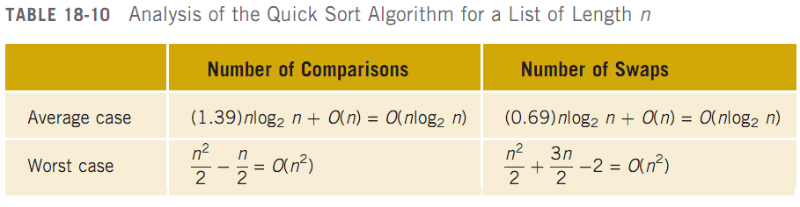
Analysis: Quick Sort

Slide 129
Quicksort
Time complexities of Quicksort
  best: Θ( n lg n )
  average: Θ( n lg n )
  worst: Θ( n² )
The average case usually dominates over the worst case in sorting algorithms, and in Quicksort, the coefficient of the n lg n term is small
  makes Quicksort one of the most popular general-purpose sorting algorithms

Slide 130
Merge Sort
z Divide-And-Conquer Algorithm
• Divides a file in two halves
• Merges sorted halves
z The “opposite” of quick sort
z Requires additional storage

Slide 131
Merge Sort
Quick sort: O(nlog₂n) average case; O(n²) worst case
Merge sort: always O(nlog₂n)
  Uses the divide-and-conquer technique
    Partitions the list into two sublists
    Sorts the sublists
    Combines the sublists into one sorted list
  Differs from quick sort in how list is partitioned
    Divides list into two sublists of nearly equal size

Slide 132
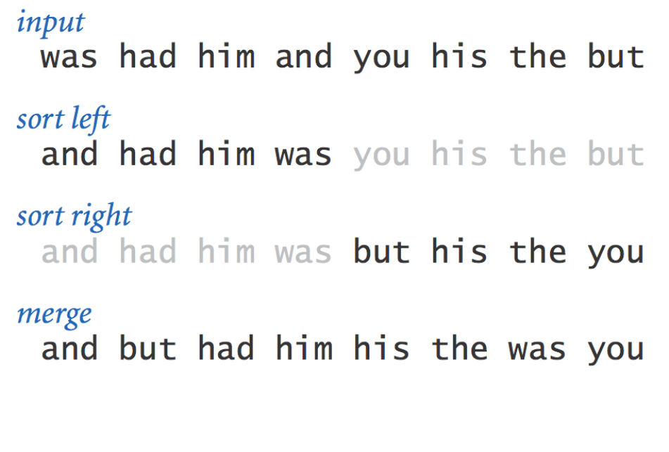
Mergesort
Algorithm:
•
•
•
Divide array into two halves.
Recursively sort each half.
Merge
two
halves
to
make
sorted
whole.
3

Slide 133
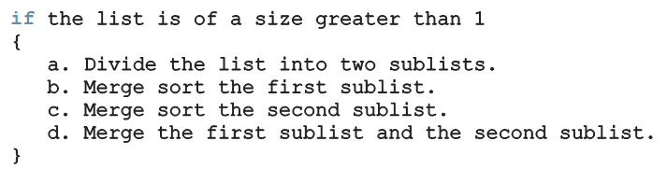
Merge Sort: Linked List-Based Lists (cont’d.)
General algorithm:
Uses recursion

Slide 134
C Code: Merge Sort
void
{
mergesort(Item
a[],
int
start,
int
stop)
int
m
=
(start
+
stop)/2;
if
(stop
<=
start)
return;
mergesort(a,
mergesort(a,
start,
m);
stop);
m
+
1,
merge(a,
}
start,
m,
stop);

Slide 135
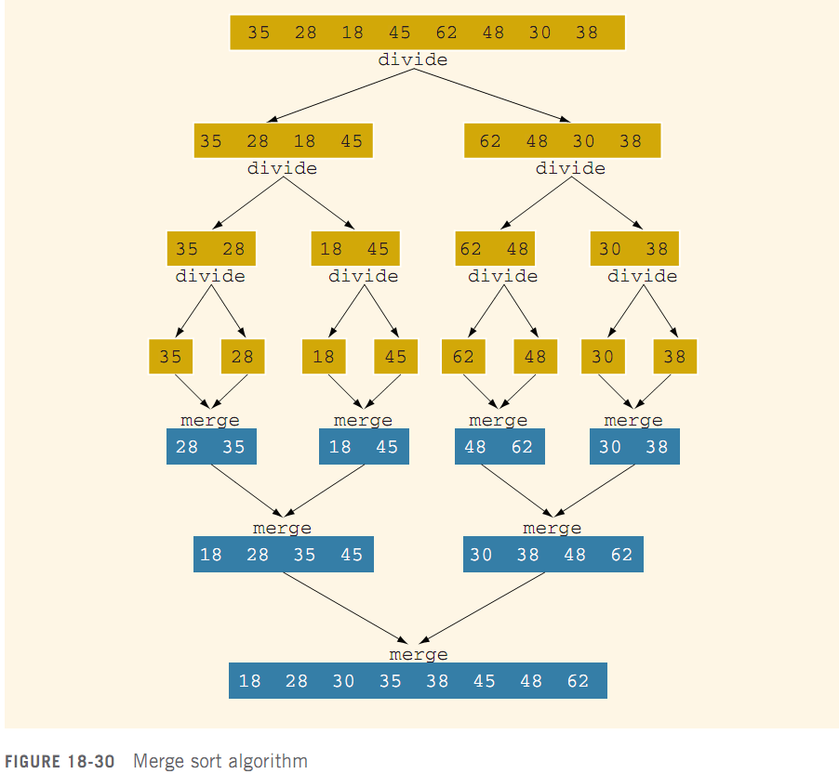
Merge Sort

Slide 136
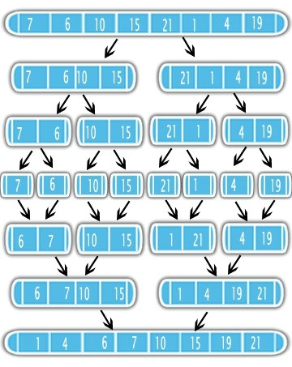


Mergesort:
Breakdown
4

Slide 137
Mergesort:
trace
a[]
0 1 2 3 4 5 6 7 8 9 10 11 12 13 14 15
lo
hi
M
E
E
E
E
E
E
E
E
E
E
E
E
E
E
A
E
M
M
G
G
G
G
E
E
E
E
E
E
E
E
E
R
R
G
M
M
M
M
G
G
G
G
G
G
G
G
E
G
G
R
R
R
R
R
M
M
M
M
M
M
M
M
E
E
E
E
E
E
E
E
O
O
O
O
O
O
O
O
E
S
S
S
S
S
S
O
R
R
R
R
R
R
R
R
G
O
O
O
O
O
O
R
R
R
R
R
R
R
R
R
L
R
R
R
R
R
R
S
S
S
S
S
S
S
S
S
M
T
T
T
T
T
T
T
T
E
E
A
A
A
A
A
M
E
E
E
E
E
E
E
E
T
T
E
E
E
E
E
O
X
X
X
X
X
X
X
X
X
A
T
T
T
T
E
P
A
A
A
A
A
A
A
A
A
X
X
X
X
X
L
R
M
M
M
M
M
M
M
M
M
M
M
M
M
E
M
R
P
P
P
P
P
P
P
P
P
P
P
P
P
L
P
S
L
L
L
L
L
L
L
L
L
L
L
L
E
M
T
T
E
E
E
E
E
E
E
E
E
E
E
E
L
P
X
X
merge(a, aux,
merge(a, aux,
0,
2,
0,
2,
1)
3)
merge(a, aux,
0,
1,
4,
6,
5,
3)
5)
7)
7)
merge(a, aux,
merge(a, aux,
4,
6,
merge(a, aux,
4,
merge(a, aux,
0,
3,
8,
10,
7)
8,
10,
merge(a, aux,
merge(a, aux,
9)
11)
merge(a, aux,
8,
9, 11)
merge(a, aux, 12, 12, 13)
merge(a, aux, 14, 14, 15)
merge(a, aux, 12, 13, 15)
merge(a, aux,
8, 11, 15)
merge(a, aux,
0,
7, 15)
result
after
recursive call
9

Slide 138
Example 5.10, Example 5.11

Slide 139

Analysis: Merge Sort
Suppose that L is a list of n elements, with n > 0
Suppose that n is a power of 2; that is, n = 2^{m} for some integer m > 0, so that we can divide the list into two sublists, each of size:
  m will be the number of recursion levels

Slide 140
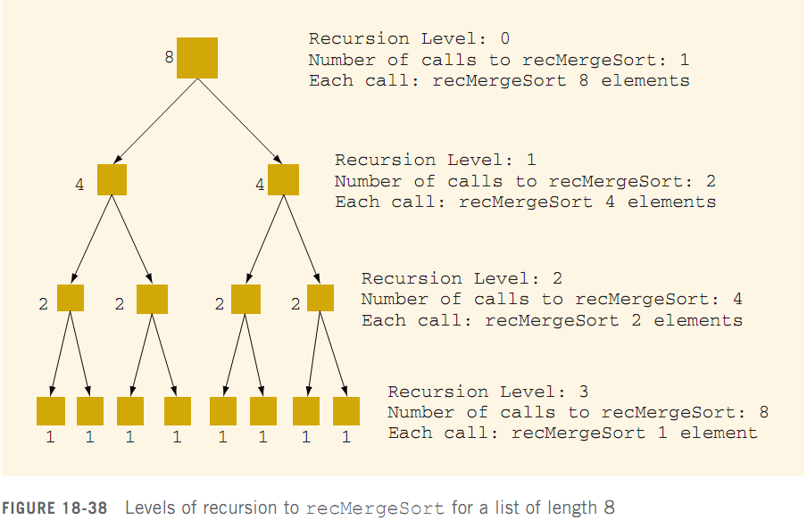
Analysis: Merge Sort

Slide 141

Analysis: Merge Sort
To merge two sorted lists of size s and t, the maximum number of comparisons is s + t − 1
Function mergeList merges two sorted lists into a sorted list
  This is where the actual comparisons and assignments are done
Max. # of comparisons at level k of recursion:

Slide 142

Analysis: Merge Sort
The maximum number of comparisons at each level of the recursion is O(n)
  Maximum number of comparisons is O(nm), where m = number of levels of recursion
  Thus, O(nm) ≡ O(n log₂n)
W(n): # of key comparisons in worst case
A(n): # of key comparisons in average case

Slide 143
Summary
Both the quick sort and merge sort algorithms sort a list by partitioning it
  Quick sort: average number of key comparisons is O(nlog₂n); worst case number of key comparisons is O(n²)
  Merge sort: number of key comparisons is O(nlog₂n)

